Slide 1
Ancient Greek for Everyone: A New Digital Resource for Beginning Greek
2013 edition
Wilfred E. Major
wmajor@lsu.edu

Slide 2
Ancient Greek for Everyone
This class
practice with the Greek alphabet
Greek words with English derivatives

Slide 3
Ancient Greek for Everyone
Practice with English derivatives
The following slides give ancient Greek words with their definitions.
Say them out loud in Greek.
Match them up with modern English words.
How do you think the ancient definitions led to the modern ones?

Slide 4
Ancient Greek for Everyone
ἀγάπη love, charity
ἄγγελος messenger
ἀθλητής competitor for a prize
Aἰθιοπία land of the burnt-faced people
ἀμοιβή exchange
ἀμνηστία forgetting
ἀναρχία a place or time with no ruler
ἀποκάλυψις uncovering, revelation
ἀπόστολος ambassador
ἄρωμα spice

Slide 5
Ancient Greek for Everyone
αὐτόματον spontaneous
ἁρμονία joint, agreement
ἄτομος uncut
βίος life
βοτάνη grass
γένεσις birth
γεωμετρία measuring the earth
γράμμα letter (of the alphabet)
γραφή writing, drawing
γυμνάσιον a place for exercising

Slide 6
Ancient Greek for Everyone
δαίμων divinity, demon
δημοκρατία people-power
διάβολος deceiver
δίπλωμα paper folded in half
δόγμα opinion, decree
δρᾶμα action
δύω two
ἐγώ I
εἰρήνη peace
εὐαγγέλιον (reward for) good news

Slide 7
Ancient Greek for Everyone
ζωή life
ἱπποπόταμος river horse
ἱστορία research
καρδία heart
κατάλογος enrollment register
κλῖμαξ ladder
κόσμος order
κρατήρ mixing bowl
κρίσις judgment
κύριος, Κύριε master, Lord

Slide 8
Ancient Greek for Everyone
κύκλος circle
μαθηματικά mathematics
μανία madness
μαρτυρία testimony
μηχανικός engineer
μισογύνης woman hater
μυστήριον secret
οἰκονομία household management
ὂ μικρόν small “o”
παλίνδρομος running backward

Slide 9
Ancient Greek for Everyone
παραβολή comparison, parable
πνευμονία lung disease
ποιητής maker, creater
πολιτικά politics
προφήτης interpreter
ῥαψῳδία recitation
ῥητορική the field of speechmaking
ῥινόκερως horn-nosed
σκελετόν dried out
σοφία wisdom

Slide 10
Ancient Greek for Everyone
σπέρμα seed
ὑπόθεσις foundation, principle, plan
ὑστερική woman suffering in her womb
φιλοσοφία love of wisdom
φωσφόρος bringing light
φωνή voice
χαρακτήρ mark
χάρισμα grace, gift
ψυχή soul
ὦ μέγα big “o”

Slide 11
Ancient Greek for Everyone
Practice with English derivatives
The following slides give lists of ancient Greek words and an additional word to be added to each of them.
Combine them to form modern English words.
How do you think the ancient definitions led to the modern ones?

Slide 12
Ancient Greek for Everyone
ἀρχαῖος ancient
ἀστέροι stars
βίος life
εὖ well
ζῷον living thing
θεός god
μῦθος story
οἶκος home (hint: οι is later pronounced ē)
τέχνη skill
χρόνος time
+ λόγος word, understanding

Slide 13
Ancient Greek for Everyone
ἄλλος other
ἀπάτη deception
βροντή thunder
δεῖνος awesome
στέγος roof
τύραννος tyrant
+ σαῦρος lizard

Slide 14
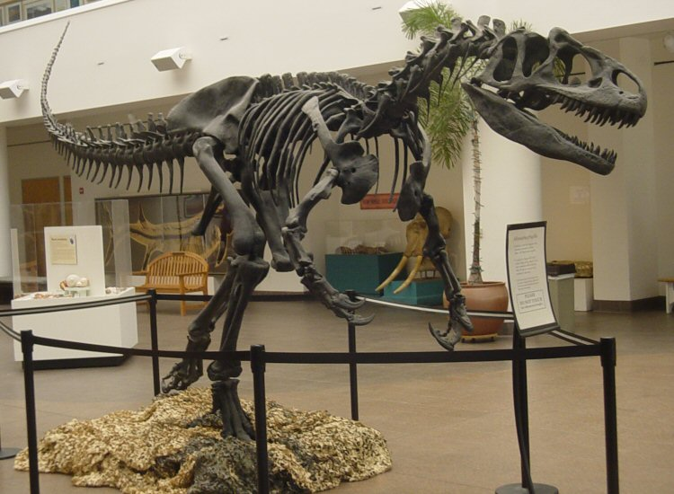
Ancient Greek for Everyone
ἄλλος other Allosaurus
ἀπάτη deception
βροντή thunder
δεῖνος awesome
στέγος roof
τύραννος tyrant
+ σαῦρος lizard
Notes:
Mounted A. fragilis skeleton cast, San Diego Natural History Museum (Wikipedia)

Slide 15
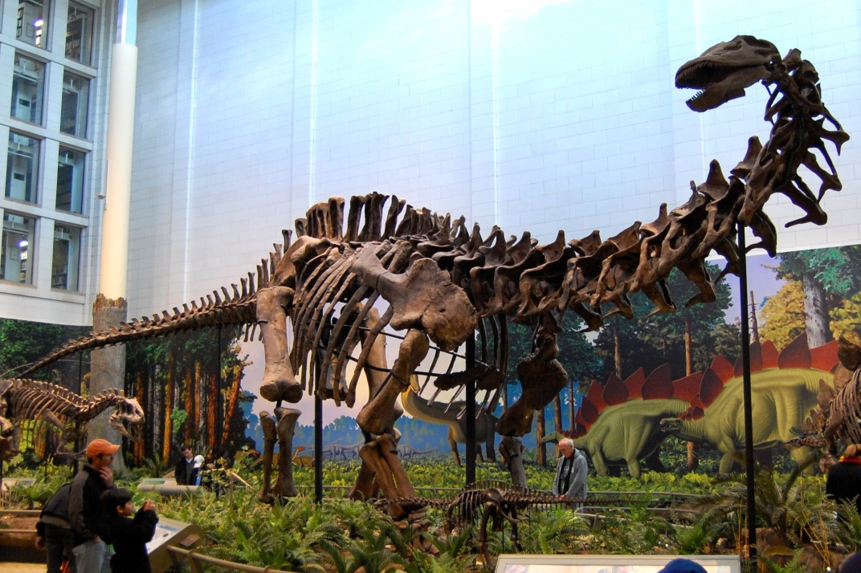
Ancient Greek for Everyone
ἄλλος other
ἀπάτη deception Apatasaurus
βροντή thunder
δεῖνος awesome
στέγος roof
τύραννος tyrant
+ σαῦρος lizard
Notes:
Mounted skeleton of A. louisae, Carnegie Museum of Natural History (Wikipedia)

Slide 16
Ancient Greek for Everyone
ἄλλος other
ἀπάτη deception
βροντή thunder Brontosaurus
δεῖνος awesome
στέγος roof
τύραννος tyrant
+ σαῦρος lizard

Slide 17
Ancient Greek for Everyone
ἄλλος other
ἀπάτη deception
βροντή thunder
δεῖνος awesome Dinosaur
στέγος roof
τύραννος tyrant
+ σαῦρος lizard

Slide 18
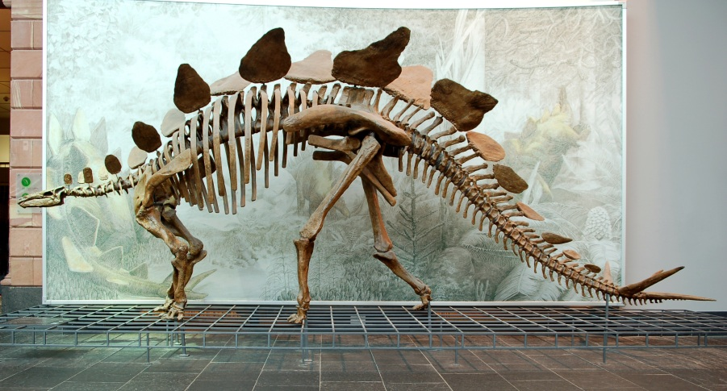
Ancient Greek for Everyone
ἄλλος other
ἀπάτη deception
βροντή thunder
δεῖνος awesome
στέγος roof Stegosaurus
τύραννος tyrant
+ σαῦρος lizard
Notes:
Reconstructed S. stenops skeleton, Senckenberg Museum (Wikipedia)

Slide 19
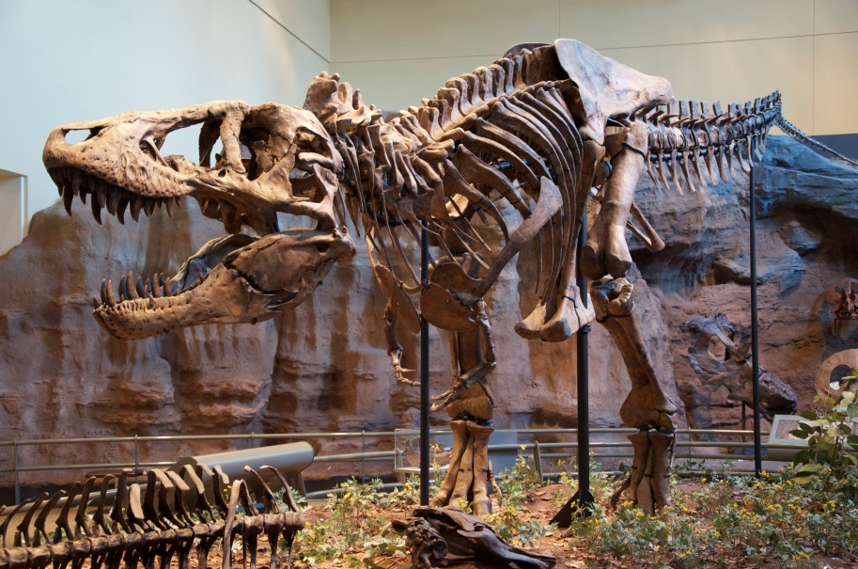
Ancient Greek for Everyone
ἄλλος other
ἀπάτη deception
βροντή thunder
δεῖνος awesome
στέγος roof
τύραννος tyrant Tyrannosaurus
+ σαῦρος lizard
Notes:
Reconstructed type specimen (CM 9380) at the Carnegie Museum of Natural History (Wikipedia)

Slide 20
Ancient Greek for Everyone
πέντε five
ἕξ six
ἑπτά seven
ὀκτώ eight
δέκα ten
δώδεκα twelve
+ γόνυ knee

Slide 21
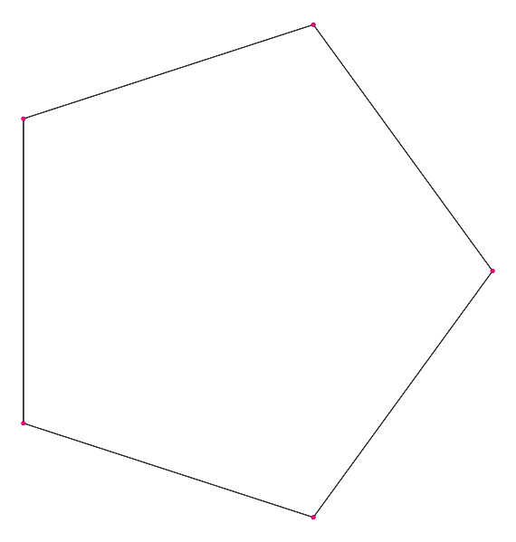
Ancient Greek for Everyone
πέντε five: pentagon
ἕξ six
ἑπτά seven
ὀκτώ eight
δέκα ten
δώδεκα twelve
+ γόνυ knee
Notes:
Line drawing from Wikipedia

Slide 22
Ancient Greek for Everyone
πέντε five
ἕξ six: hexagon
ἑπτά seven
ὀκτώ eight
δέκα ten
δώδεκα twelve
+ γόνυ knee
Notes:
Line drawing from Wikipedia

Slide 23
Ancient Greek for Everyone
πέντε five
ἕξ six
ἑπτά: seven
ὀκτώ eight
δέκα ten
δώδεκα twelve
+ γόνυ knee
Notes:
Line drawing from Wikipedia

Slide 24
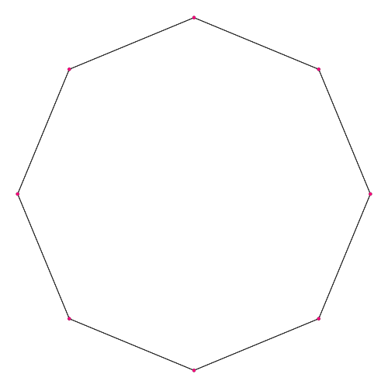
Ancient Greek for Everyone
πέντε five
ἕξ six
ἑπτά seven
ὀκτώ eight: octagon
δέκα ten
δώδεκα twelve
+ γόνυ knee
Notes:
Line drawing from Wikipedia

Slide 25
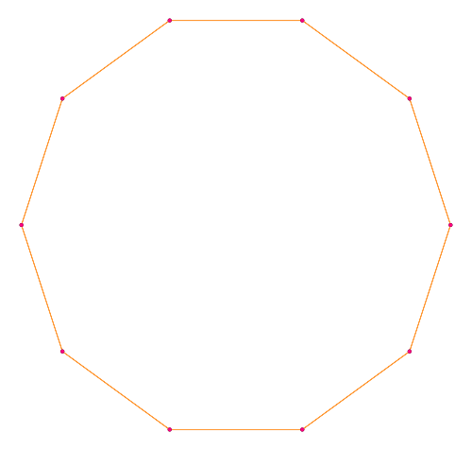
Ancient Greek for Everyone
πέντε five
ἕξ six
ἑπτά seven
ὀκτώ eight
δέκα ten: decagon
δώδεκα twelve
+ γόνυ knee
Notes:
Line drawing from Wikipedia

Slide 26
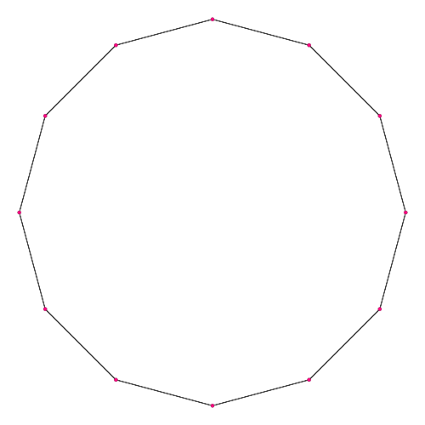
Ancient Greek for Everyone
πέντε five
ἕξ six
ἑπτά seven
ὀκτώ eight
δέκα ten
δώδεκα twelve: dodecagon
+ γόνυ knee
Notes:
Line drawing from Wikipedia

Slide 27
Ancient Greek for Everyone
βαρύς weight
παιδίον little child
ποδές feet
ψυχή soul
+ ἰατρικά healing, medical

Slide 28
Ancient Greek for Everyone
If φιλία means “love,” based on the word “necrophilia,” can you figure out what νεκρός means?
If ἀράχνης means “spider,” based on the word “arachnophobia,” can you figure out what φόβος means?

Slide 29
Ancient Greek for Everyone
Based on the word “pyromania,” can you figure out what the words πῦρ and μανία mean?
If πάρδαλις refers to a leopard, or something with leopard spots, and κάμηλος is a camel, can you guess what animal a καμηλοπάρδαλις is?

